Slide 1
Effect Size and Power

Slide 2
When the null hypothesis is true
1-sample t-test
n = 25

Slide 3
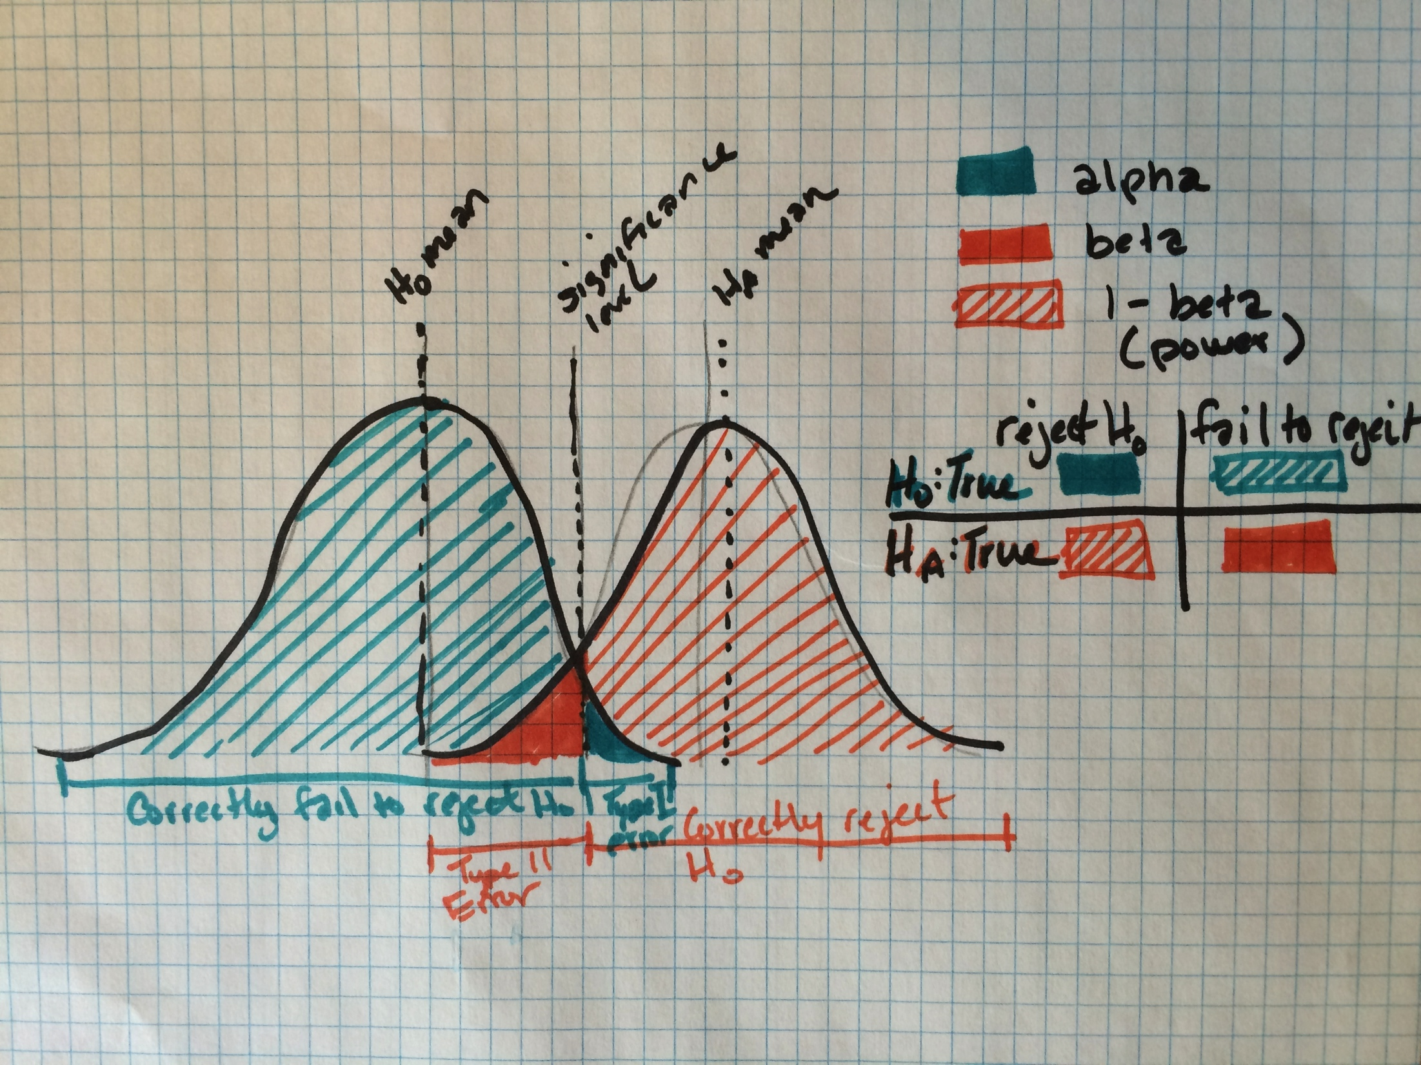

Slide 4
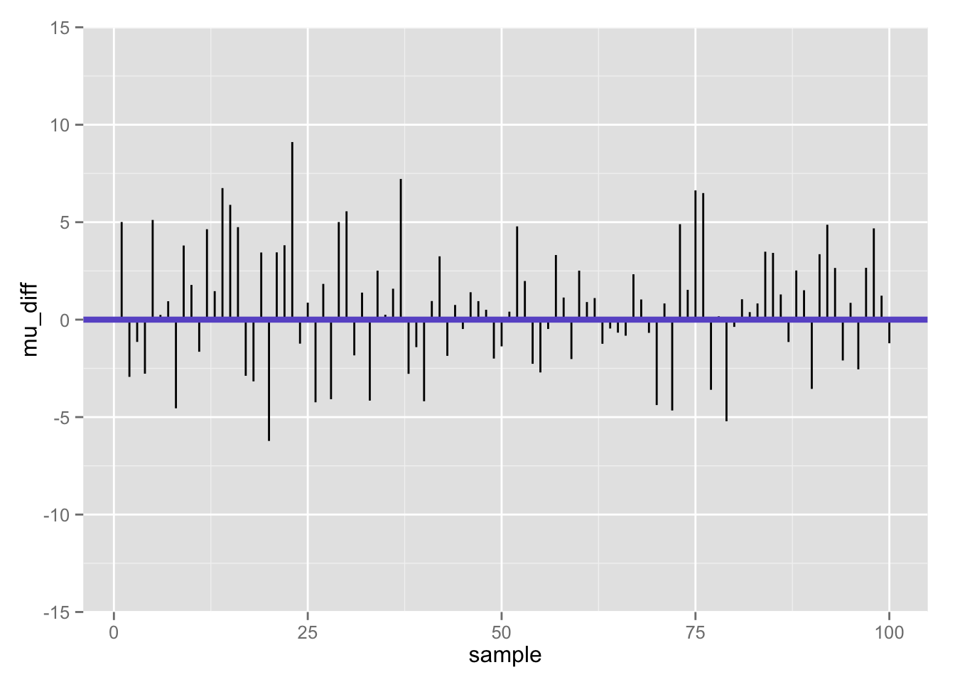
Differences between population mean and sample mean (100 samples) when null is true

Slide 5
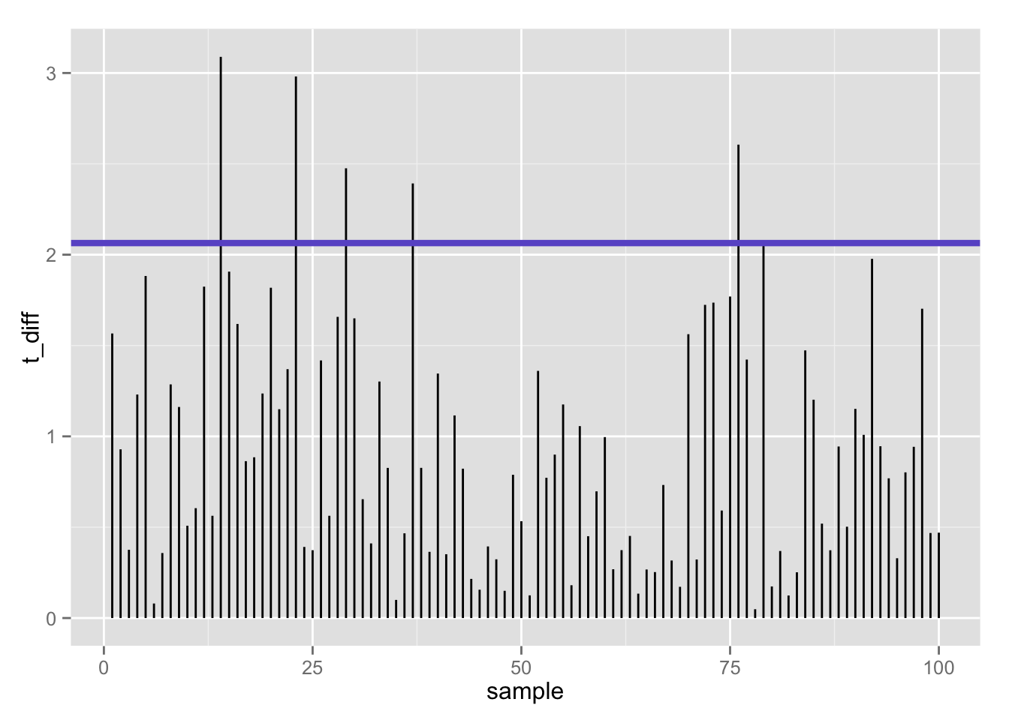
100 t-statistics (absolute value) when null is true: 5% false positives using t-test (𝛂 = .05/2)

Slide 6
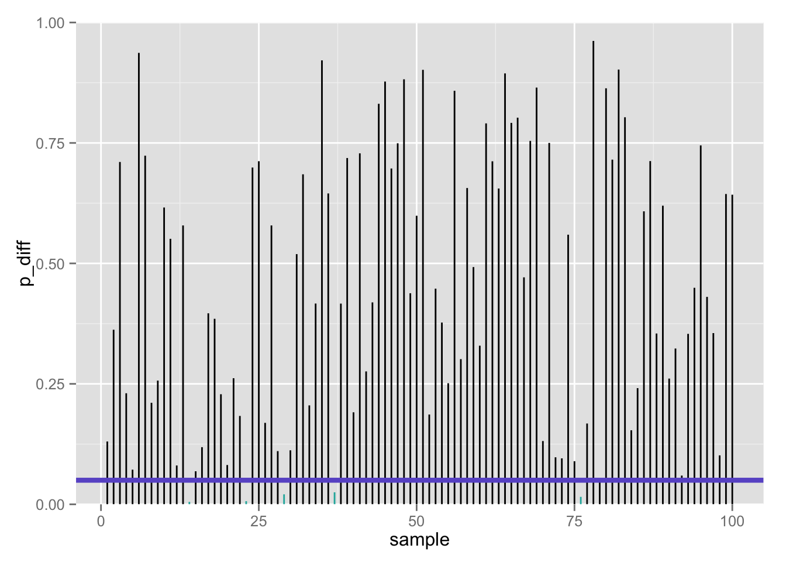
100 p-values when null is true: 5% false positives using t-test (𝛂 = .05/2)

Slide 7
Effect Size and Power

Slide 8

Confusion matrix
 | Call based on observed data
True state of the world | Fail to reject H₀ | Reject H₀
H₀ | True negative 1 – 𝝰 | False positive Type I error 𝝰 | # true H₀’s
H₁ | False negative Type II error 𝛃 | True positive 1 – 𝛃 | # true H₁’s
 |  | # rejected H₀’s | # total tests
If the null is true…

Slide 9
Confusion matrix
 | Call based on observed data
True state of the world | Fail to reject H₀ | Reject H₀
H₀ | True negative 1 – 𝝰 | False positive Type I error 𝝰 | # true H₀’s
H₁ | False negative Type II error 𝛃 | True positive 1 – 𝛃 | # true H₁’s
 |  | # rejected H₀’s | # total tests
But… what if we are wrong??

Slide 10
“Statistics does not tell us
whether we are right.
It tell us the chances
of being wrong.”
http://www.nature.com/nmeth/journal/v10/n9/full/nmeth.2613.html

Slide 11


Two ways we can be wrong…
Type 1 error (𝛂)
False positive
Type II error (𝛃)
False negative
“You’re not pregnant”
“You’re pregnant”

Slide 12
One way we can be wrong…
Type 1 error (𝛂)
False positive
Call: reject H₀
If we had rejected the null, it is of course possible that we should not have!
That is, the true state of the world may be H₀ (he’s not pregnant), but our sample data leads us to reject H₀ and (incorrectly) conclude that he’s pregnant
This is really embarrassing, so we control this: 𝛂 = ?
“You’re pregnant”

Slide 13
The other way we can be wrong…
Call: fail to reject H₀
Type II error (𝛃)
False negative
If we conclude that we cannot reject the null, it is of course possible that we should have!
That is, the true state of the world may be H₁ (she’s pregnant), but our sample data says we don’t have good enough evidence to reject H₀ (she’s not pregnant)
“You’re not pregnant”

Slide 14
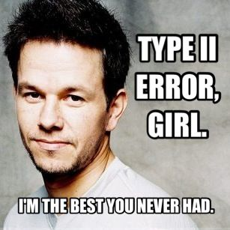
Type II errors
The one(s) that got away…

Slide 15







In our aspiring astronauts example…
Type 1 error (𝛂)
False positive
Type II error (𝛃)
False negative
Decide:
“You are smarter than average!”
Reality:
but you are actually not
Decide:
“You’re not smarter than average!”
Reality:
but you are actually

Slide 16
What if: the null hypothesis is FALSE?
1-sample z-test
n = 25

Slide 17
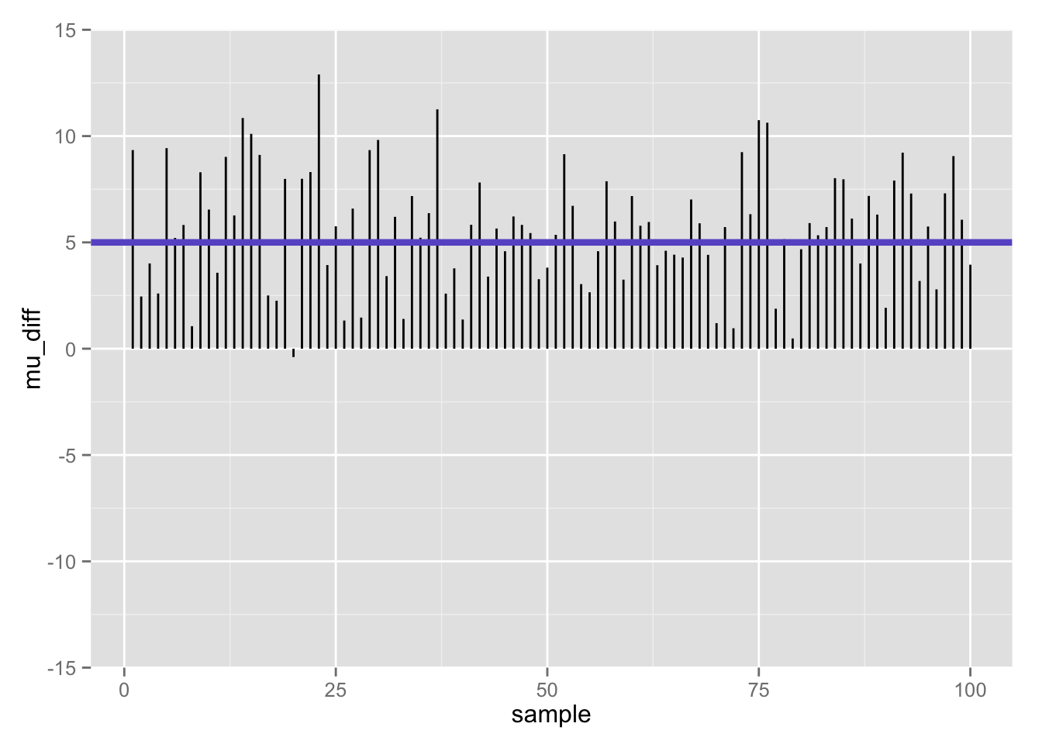

Slide 18
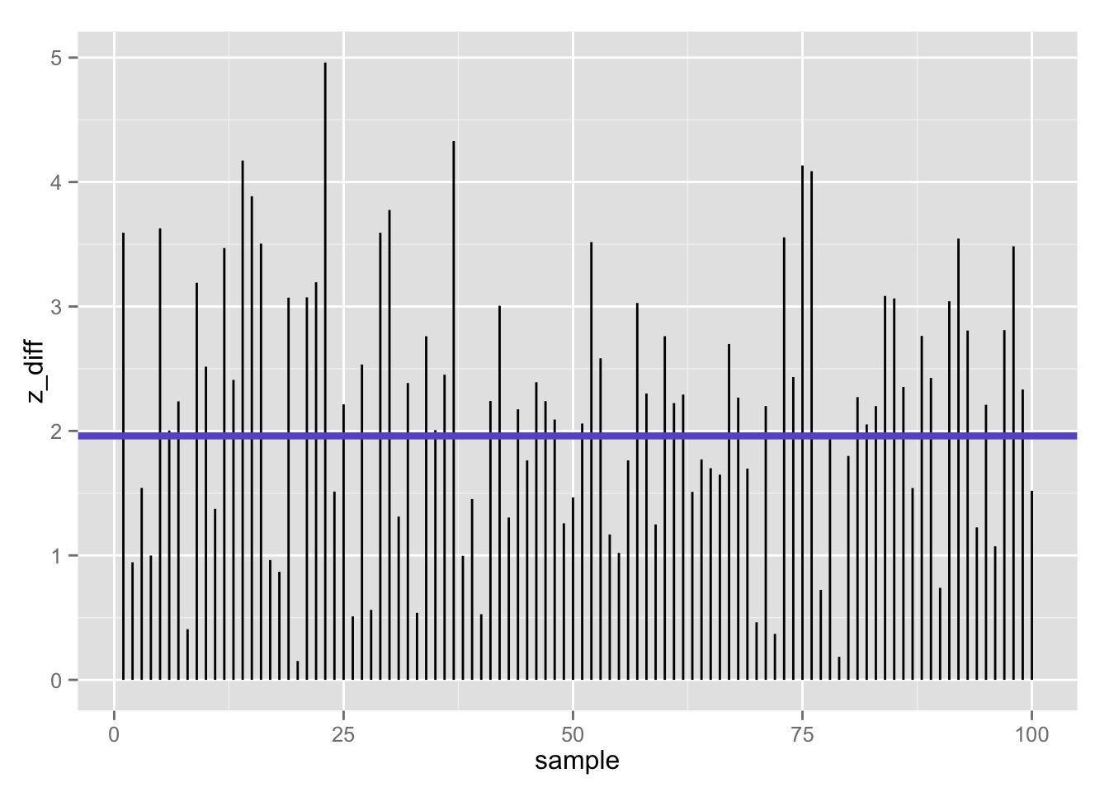
100 z-statistics (absolute value) when null is false: 39% false negatives using z-test (𝛂 = .05/2)
Flip side (1 −𝛃):
61% true positives

Slide 19
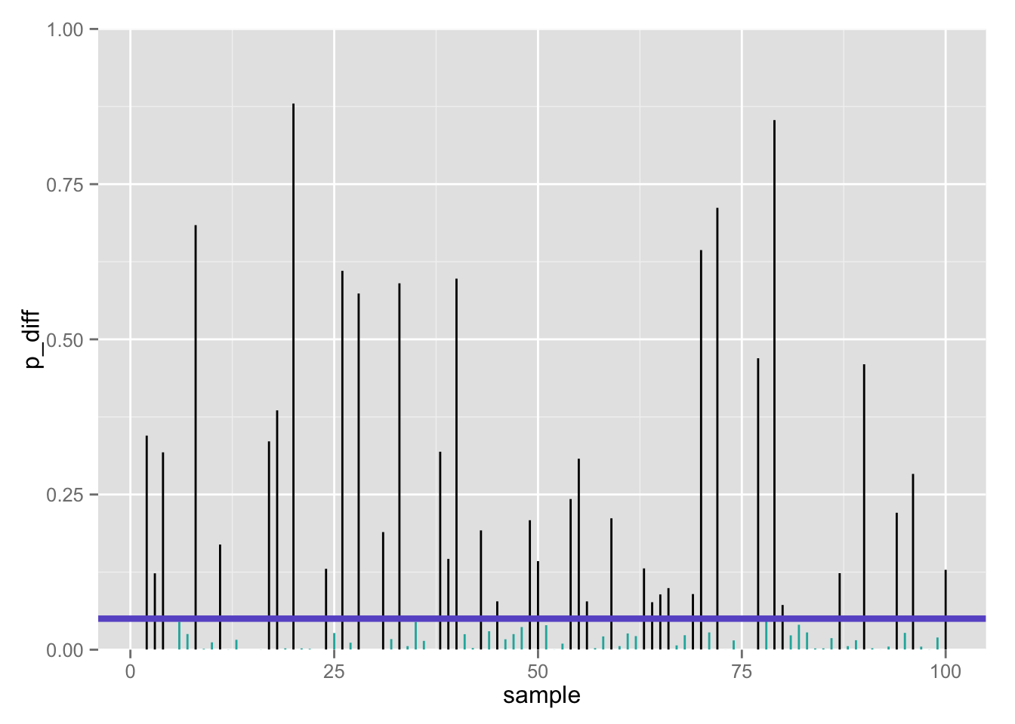
100 p-values when null is false: 39% false negatives using z-test (𝛂 = .05/2)
Flip side (1 −𝛃):
61% true positives

Slide 20
What if: the null hypothesis is FALSE?
1-sample t-test
n = 25

Slide 21
Differences between population mean and sample mean (100 samples) when null is false

Slide 22
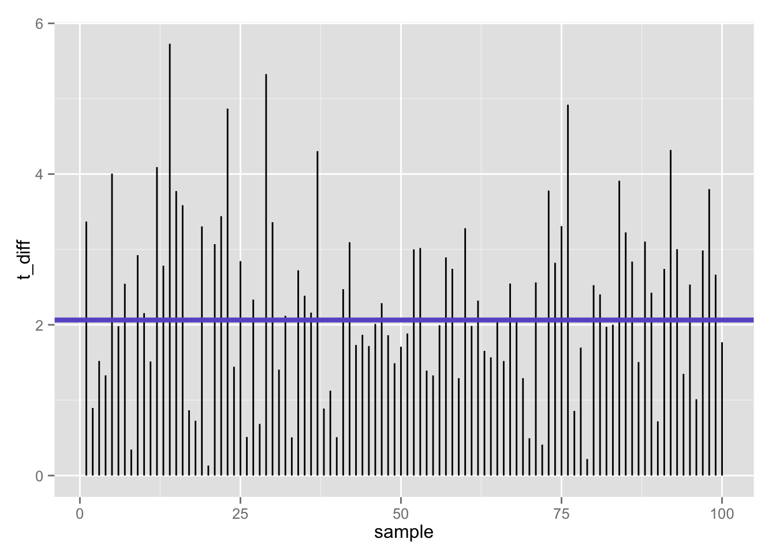
100 t-statistics (absolute value) when null is false: 47% false negatives using t-test (𝛂 = .05/2)
Flip side (1 −𝛃):
53% true positives

Slide 23
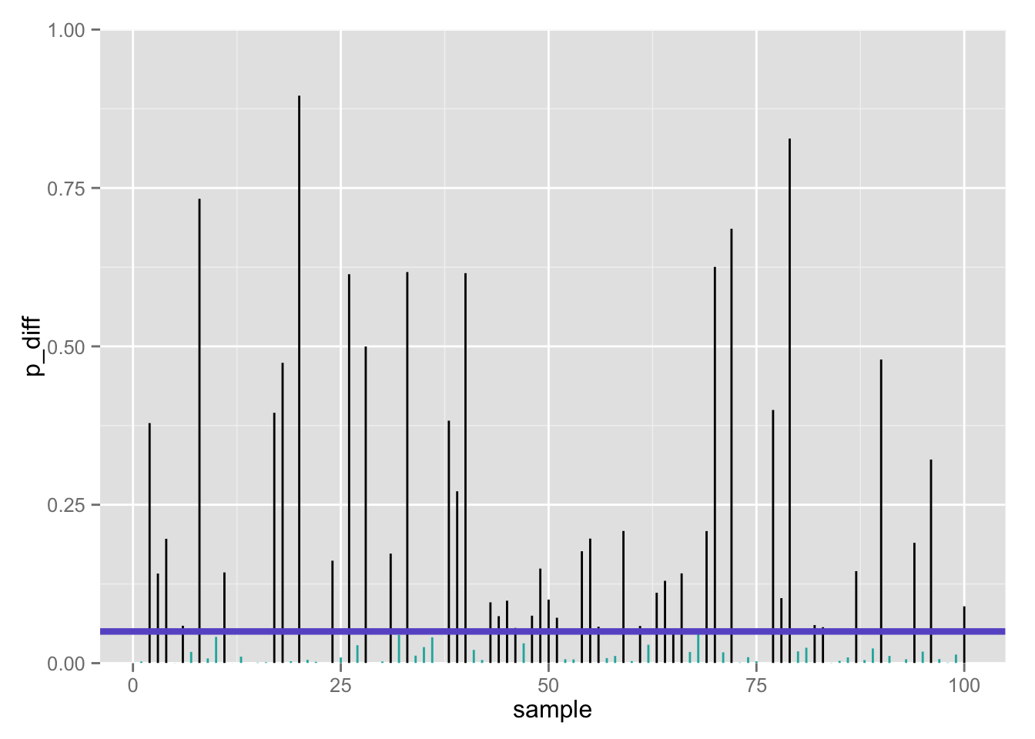
100 p-values when null is false: 47% false negatives using t-test (𝛂 = .05/2)
Flip side (1 −𝛃):
53% true positives

Slide 24

≈ 50% true positives seems low…
Only about half of our true effects would be detected in our study
Why?
Perhaps we lacked statistical power

Slide 25
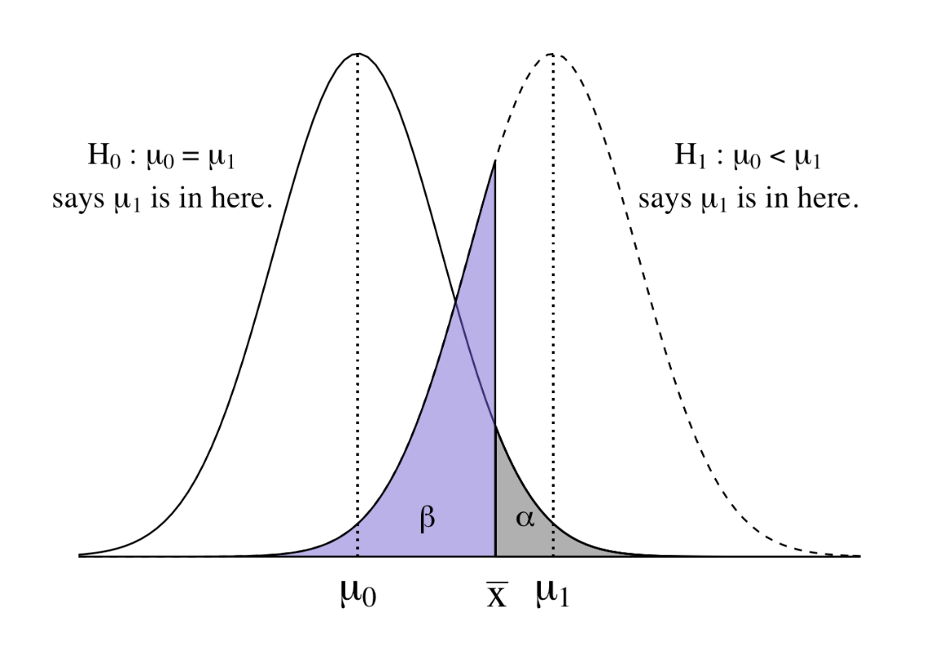
Dueling distributions
In a one-tailed test, we have two dueling hypothetical distributions:
The null distribution, centered at µ₀
The alternative distribution, centered around some specific or unspecified other mean (higher or lower?) µ₁

